Slide 1

Machine Learning-Based Healthcare Data Analytics for Early Disease Risk Predication
DATA ANALYTICS AND VISUALIZATION (24DSB3101)
^{16th September, 2026}
 | Under the Guidance of Dr . KATANGURI SWAPNIKA Department of Computer Science and Engineering, KLH University Bowrampet Campus
Team Members E. Supraja - 2420030357 M. Varshitha - 2420030479 C. Keerthana - 2420030581 CH. Bhargavi - 2420030588

Slide 2
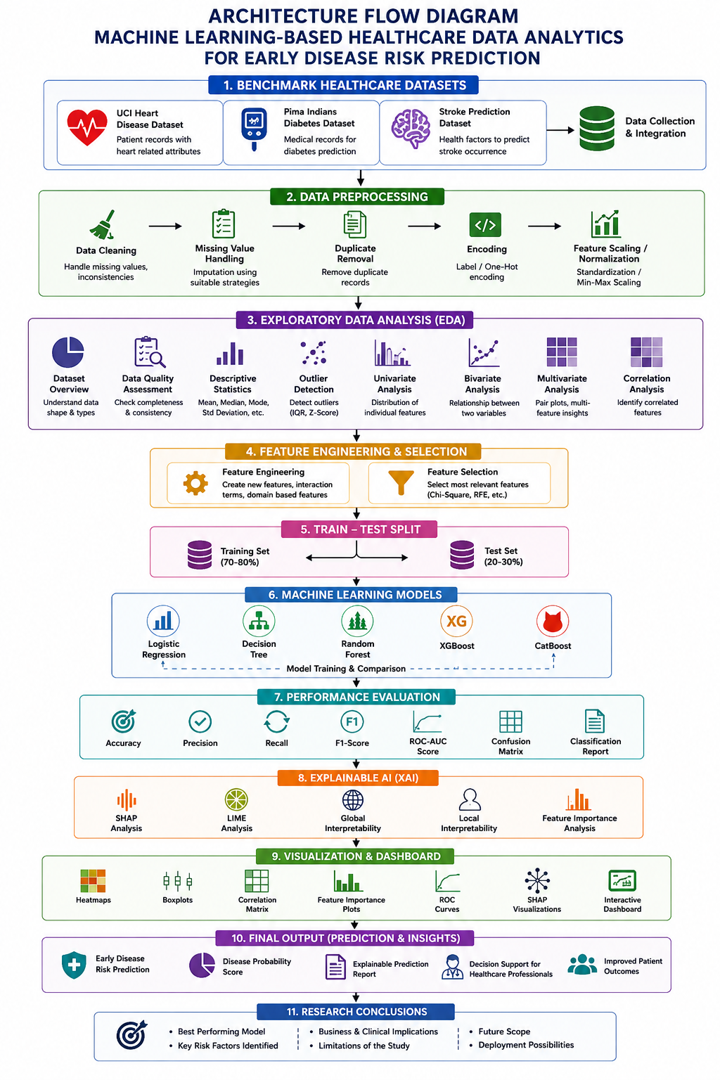
PROJECT DESIGN

Slide 3
METHODOLOGY
1. Data Collection
Use the datasets related to diabetes or heart disease.
Select relevant health-related attributes and target disease outcome.
2. Data Preprocessing
Handle missing or inconsistent values.
Remove duplicate/unnecessary records.
Convert categorical variables where required.
Scale numerical features when required.
3. Exploratory Data Analysis
Analyze distributions of health variables.
Study relationships between risk factors and disease outcomes.
Use charts and statistical measures to identify patterns.

Slide 4
METHODOLOGY
4. Feature Engineering
Select relevant features.
Transform variables where necessary.
Prepare the final feature set for machine learning.
5. Model Development
Train and compare:
Logistic Regression
Decision Tree
Random Forest
XGBoost
CatBoost
6. Evaluation
Evaluate models using appropriate classification metrics.
7. Dashboard Development
Integrate analytics, visualizations, model results and individual risk prediction into HealthScope.

Slide 5
MACHINE LEARNING APPROACH
Model | Purpose
Logistic Regression | Provides a baseline classification model for disease-risk prediction
Decision Tree | Uses decision rules based on health features to classify risk
Random Forest | Combines multiple decision trees to improve classification performance
Model Evaluation
The models will be compared using:
Accuracy
Precision
Recall
F1-Score
Confusion Matrix
Model Selection
The models will be evaluated on the same test data, and their performance will be compared to determine the most suitable model for the final risk-prediction component.

Slide 6
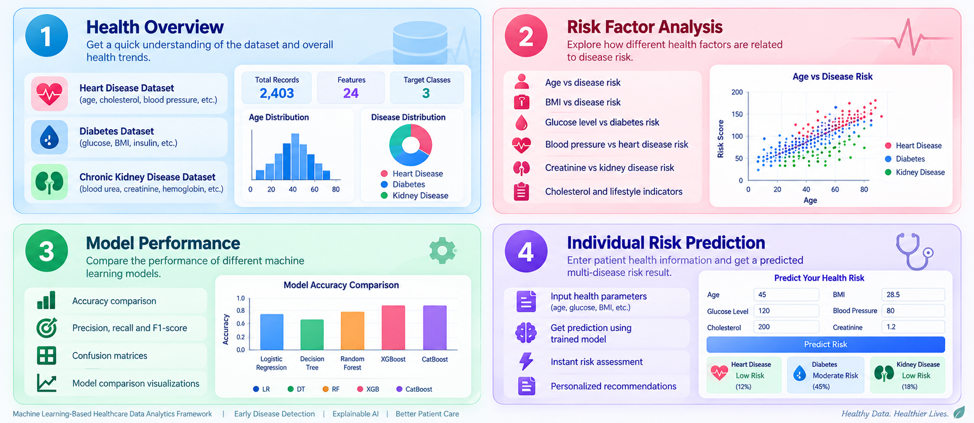
DASHBOARD DESIGN

Slide 7
TECHNICAL STACK
Area | Technology
Programming Language | Python
Data Processing | Pandas, NumPy
Data Visualization | Matplotlib, Seaborn / Plotly
Machine Learning | Scikit-learn
Dashboard | Streamlit
Model Storage | Joblib / Pickle
Dataset | Public Healthcare Dataset

Slide 8
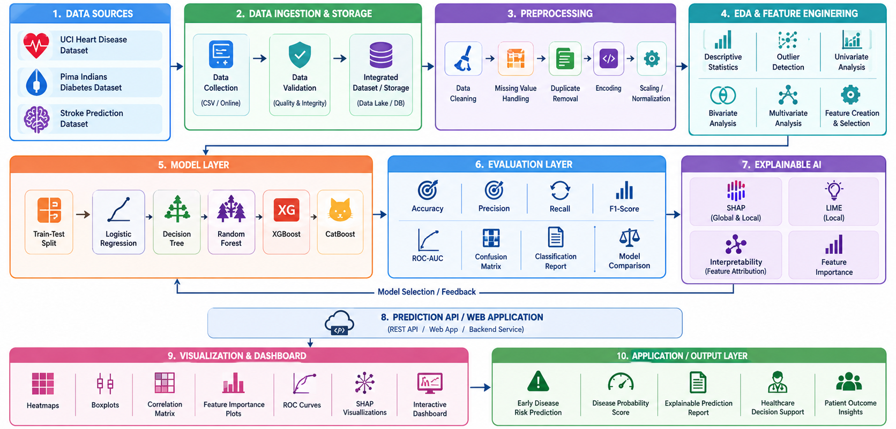
SYSTEM ARCHITECTURE

Slide 9
PROBLEM GAP IDENTIFICATION
No. | Literature | Year | Main Focus | Limitations
1 | “Why Should I Trust You?”: Explaining the Predictions of Any Classifier | 2016 | Introduced LIME (Local Interpretable Model-Agnostic Explanations), a model-agnostic method that explains individual predictions of any classifier by approximating it locally with an interpretable model. | Provides only local explanations and does not offer global interpretability or a complete healthcare-specific framework for multi-disease prediction.
2 | A Unified Approach to Interpreting Model Predictions | 2017 | Introduced SHAP (SHapley Additive exPlanations), a unified framework based on game theory to explain the output of any machine learning model by computing feature importance values for individual predictions. | Computationally expensive for large models and datasets; primarily focuses on model interpretation rather than end-to-end healthcare decision-support systems.
3 | Towards A Rigorous Science of Interpretable Machine Learning | 2017 | Discusses the need for rigorous definitions, taxonomies, and evaluation frameworks for interpretable machine learning to ensure reliability and consistency in explanations. | Conceptual and methodological in nature; does not provide a practical healthcare prediction and explanation workflow or real-world evaluation.
4 | Causality and Explainability of Artificial Intelligence in Medicine | 2019 | Explores explainability in medical AI and introduces the concept of causability, emphasizing the quality and usefulness of explanations for human understanding in medicine. | Challenges remain in distinguishing explainability from causability and in evaluating the quality of explanations in real clinical environments.
5 | Explainability for Artificial Intelligence in Healthcare: A Multidisciplinary Perspective | 2020 | Examines explainability from technological, medical, legal, ethical, and patient perspectives for clinical decision-support systems. | Highlights that explainability is not only a technical issue; integration into clinical workflows, trust, ethics, and practical adoption remain challenging.
6 | A Comprehensive Review of Explainable AI for Disease Diagnosis | 2024 | Reviews 90 Q1 journal articles on XAI for ML/DL-based disease diagnosis. | Limited standardization of XAI methods and insufficient focus on translating explanations into practical, understandable healthcare decision support.
7 | The Role of Explainable Artificial Intelligence in Disease Prediction: A Systematic Literature Review and Future Research Directions | 2025 | Reviews 30 XAI disease-prediction studies and identifies issues such as limited dataset diversity, model complexity, and single-data-type dependence. | Limited dataset diversity, model complexity, and dependence on single data types restrict the generalizability and practical use of XAI models.
8 | The Application of Explainable Artificial Intelligence in the Prediction, Diagnosis, Treatment, and Management of Chronic Diseases: A Systematic Review | 2025 | Reviews XAI applications across chronic diseases; SHAP and LIME are among the dominant methods. | Limited integration of XAI methods with practical healthcare applications and decision-support systems.
9 | Artificial Intelligence in Predictive Healthcare: A Systematic Review | 2025 | Reviews AI/ML applications in predictive healthcare and their role in proactive healthcare interventions. | Focuses mainly on predictive performance, with limited emphasis on model interpretability and user-friendly presentation of predictions.
10 | Presenting Artificial Intelligence Predictions Based on Electronic Medical Records to Clinicians in Hospitals: A Systematic Review | 2025 | Examines how AI predictions from structured hospital data are presented to clinicians. | Limited practical approaches for integrating explainable predictions into accessible and interactive clinical decision-support interfaces.

Slide 10
INNOVATION, CREATIVITY & NOVELTY
Multi-Disease Risk Prediction Framework
Predicts the risk of multiple diseases—Diabetes, Heart Disease, and Chronic Kidney Disease—using disease-specific healthcare datasets and machine learning models.
Integrated Explainable AI (XAI)
Uses SHAP to explain both overall model behavior and individual patient predictions by identifying the healthcare factors contributing to disease risk.
Advanced Comparative ML Evaluation
Compares Logistic Regression, Decision Tree, Random Forest, XGBoost, and CatBoost using Accuracy, Precision, Recall, F1-Score, ROC-AUC, and Confusion Matrix.
Clinical Risk Intelligence & Decision Support
Converts model predictions into disease-risk probabilities and interpretable risk factors, helping users understand potential health risks and supporting informed clinical assessment.
Unified Healthcare Analytics Dashboard
Provides a single interactive interface for patient risk prediction, disease analytics, model comparison, SHAP explanations, risk-factor visualization, and prediction history.

Slide 11
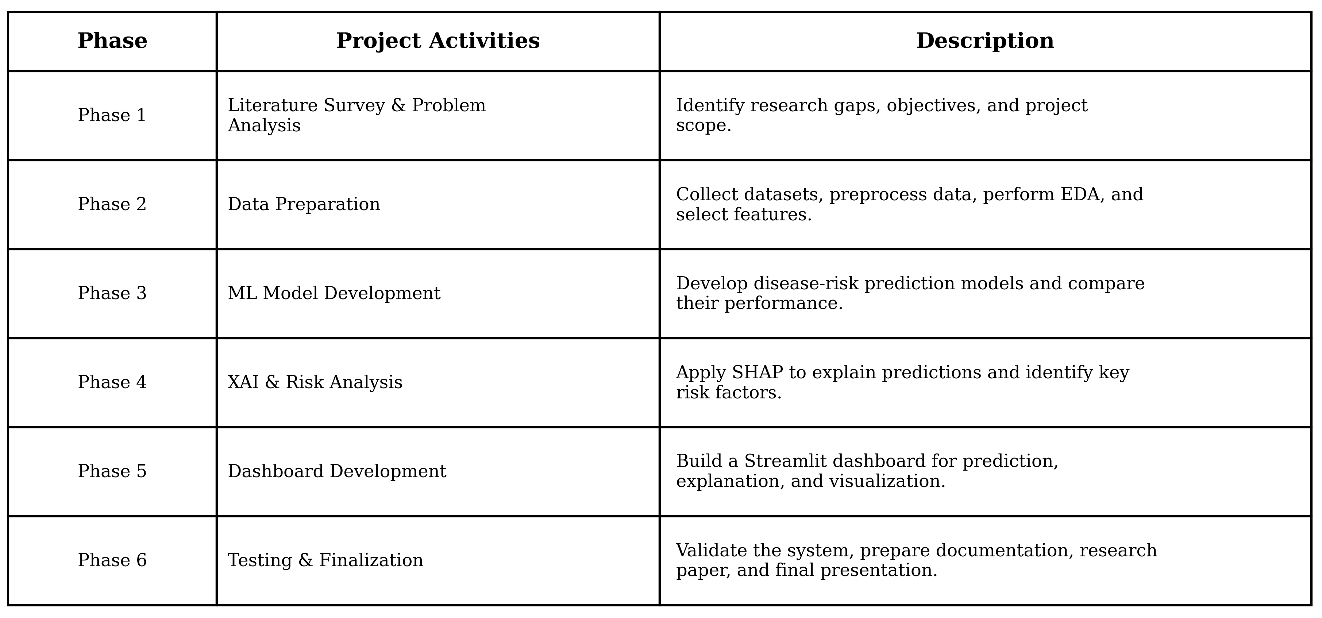
PROJECT PLAN

Slide 12
EXPECTED OUTCOME
Early Multi-Disease Risk Prediction: Predict the risk of Diabetes, Heart Disease, and Chronic Kidney Disease from patient health parameters.
Improved Prediction Performance: Identify the most suitable ML model through comparative evaluation of Logistic Regression, Decision Tree, Random Forest, XGBoost, and CatBoost.
Explainable Predictions: Use SHAP to identify the major healthcare factors influencing each patient's predicted disease risk.
Risk-Based Patient Insights: Provide disease-risk probabilities and classify patients according to their predicted risk level for easier interpretation.
Clinical Decision Support: Provide interpretable information that can assist healthcare professionals in early risk assessment and further clinical evaluation.
Healthcare Analytics Dashboard: Provide an interactive dashboard showing disease trends, risk factors, model performance, predictions, and explanations.
Reliable Model Evaluation: Evaluate models using Accuracy, Precision, Recall, F1-Score, ROC-AUC, and Confusion Matrix to assess their performance comprehensively.

Slide 13
CONCLUSION
The proposed system provides an intelligent and explainable framework for early multi-disease risk prediction using machine learning.
By combining multiple ML models with SHAP-based explainability and an interactive healthcare dashboard.
The system can provide understandable risk insights and support early assessment and clinical decision-making.

